Slide 1
Prediction Challenge 5
Peter Marchese

Slide 2
“Freestyling R”
After many predictions challenges, I decided to start out by trying out different rpart models by chance and comparing MSE values.
This was done to eliminate the risk in over-valuing certain variables leading to worse results.

Slide 3
My rpart model
After playing around with rpart variables and controls I came to a familiar conclusion from my last prediction challenge.
Using none of the variables in my code actually yielded the lowest MSE.
My lowest MSE recorded using this model was ~12.
For controls, I only used the cp control and set it to 0.0000001.

Slide 4
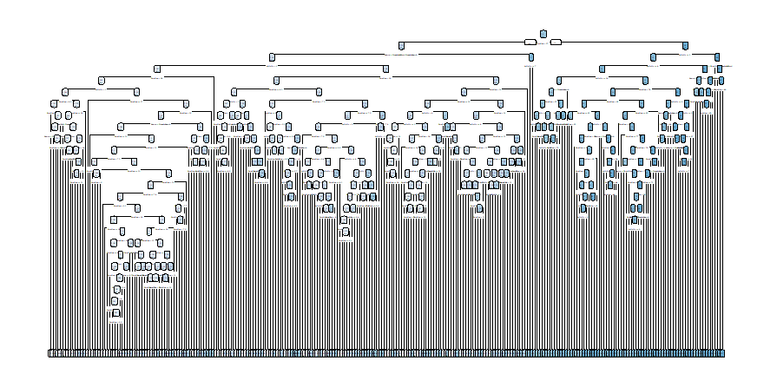
My rpart model

Slide 5

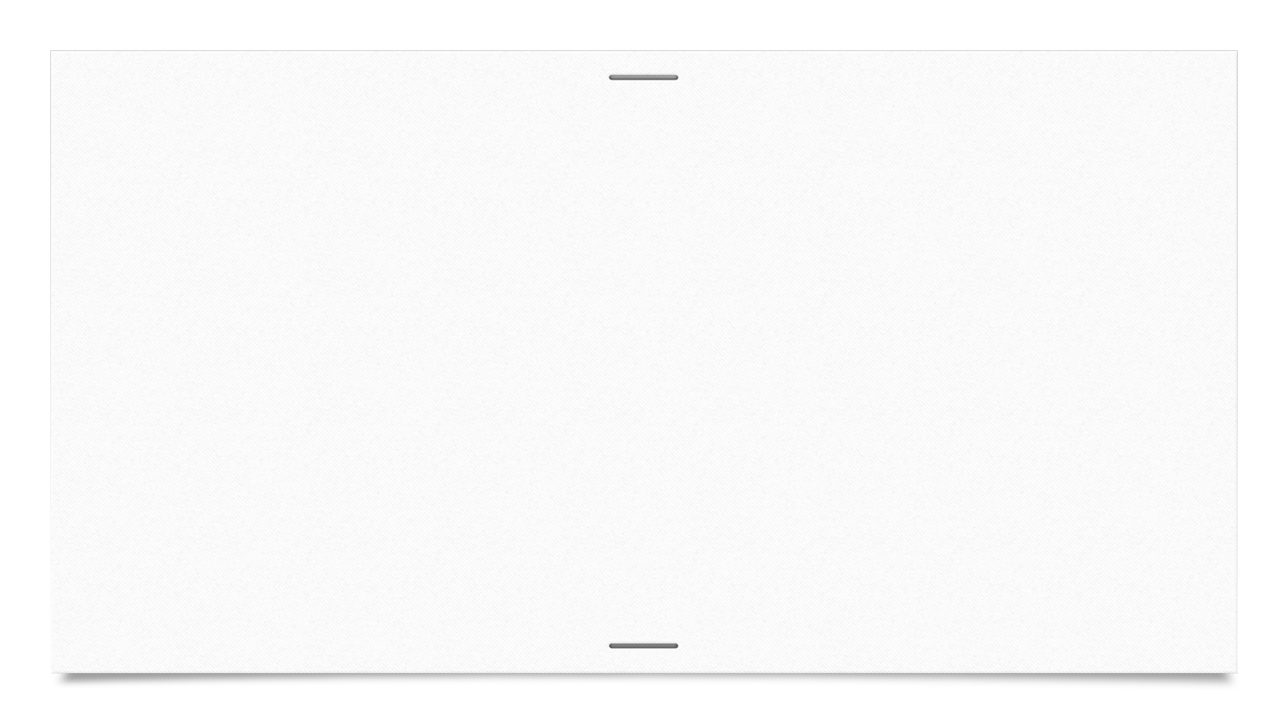

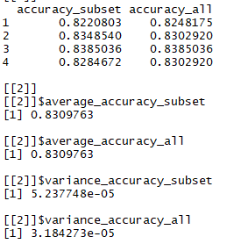
Cross-Validation
After running multiple cross validations we end up with relatively high numbers.
Not only this, but we also obtain similar values for the subset accuracy and the all accuracy.

Slide 6
Conclusion
My “rpart freestyle” paid off by generating me the lowest MSE I recorded.
I used no variables in the code itself, as well as used the cp control set to a very low fraction of a number.
Lowest MSE generated was ~12.

